Slide 1
What has being in a housegroup done for you?

Slide 2
Rooted in fellowship. Allowed me to share my personality and thoughts and develop relationships with beautiful people.

Slide 3
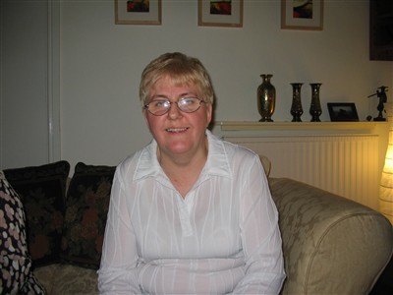
Being part of a family. Somewhere to turn for help. A place to try different things

Slide 4
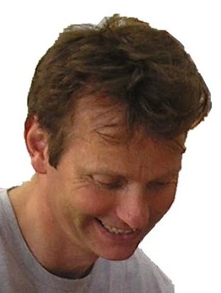
Great range of people, different perspectives, focusing on God, always a great place to come

Slide 5
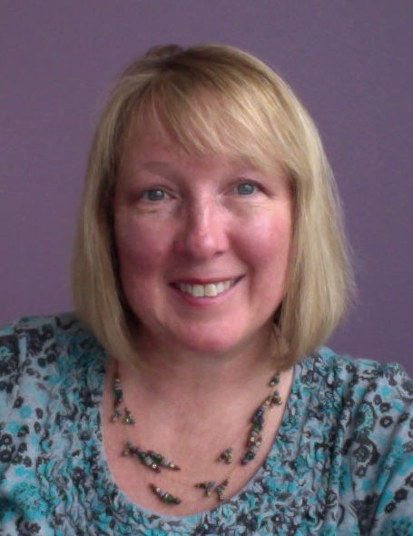
Having support when we have needed it

Slide 6
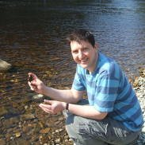
Great place to meet with friends. Given me freedom to share. Given me opportunities to do things I wouldn’t otherwise do. Helped build my confidence.

Slide 7
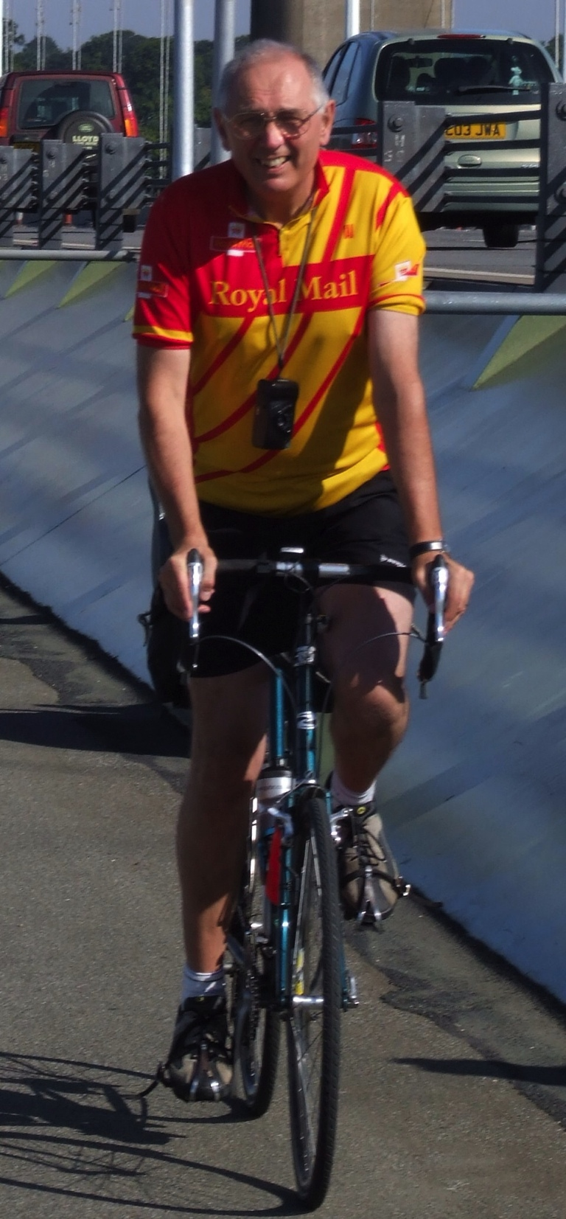
It has opened me up

Slide 8
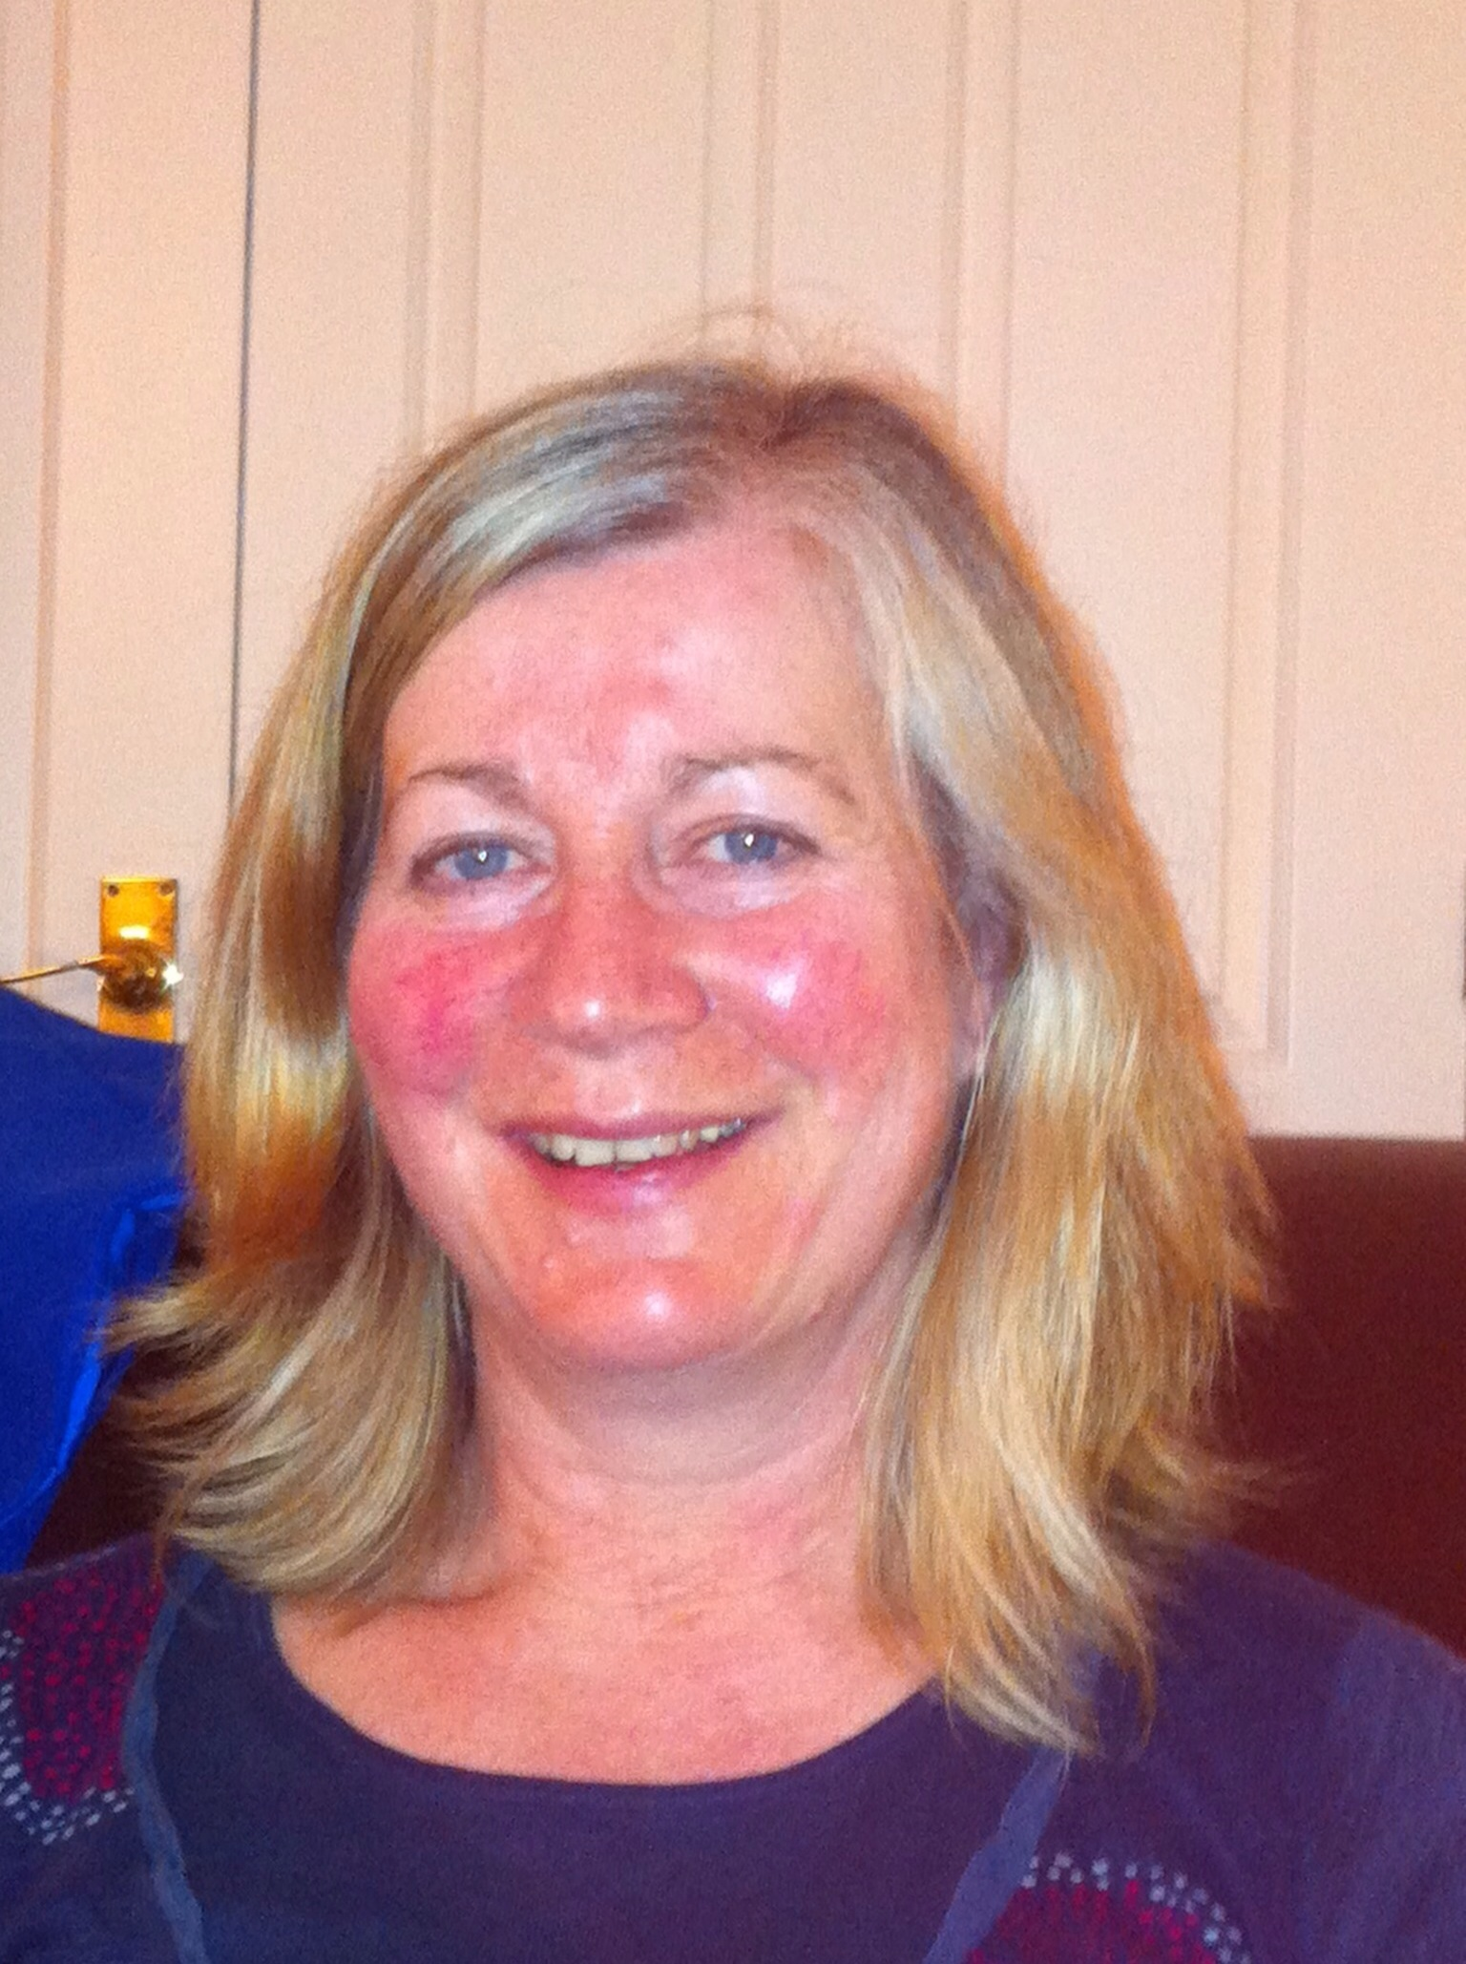
A place to belong. I love to listen to other peoples ideas & share in others lives. A place to air our doubts, worries etc.

Slide 9
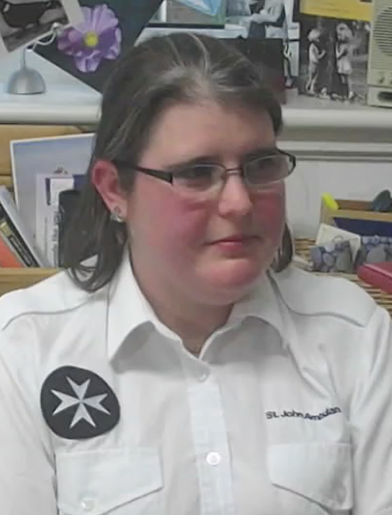
Not just support one day of the week, support every day

Slide 10
Make friends with people I might not normally meet. Be more creative in expressing my faith.

